Slide 1

Machine Learning on FIFA 2018

Slide 2
Objective
Find the winning team probability by applying machine learning algorithm on FIFA 2018 data set.

Slide 3
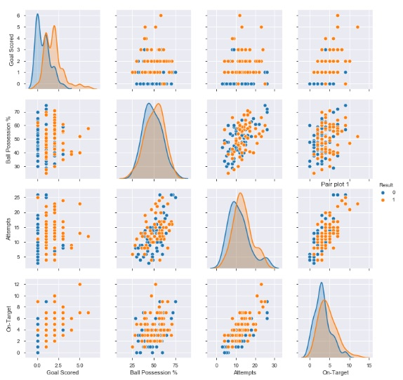
Pair plot shows relationship between Goal Scored, Ball Possession %, Attempts, On-Target

Slide 4
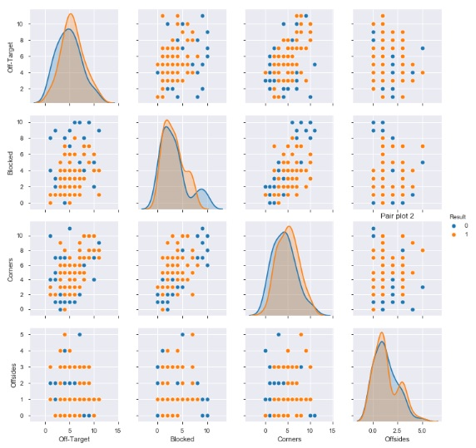
Pair plot shows relationship between Off-Target, Blocked, Corners, Off sides

Slide 5
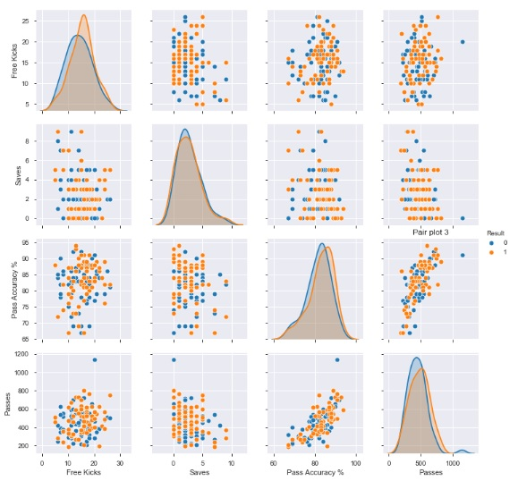
Pair plot shows relationship between Free Kicks, Saves, Pass Accuracy %, Passes

Slide 6
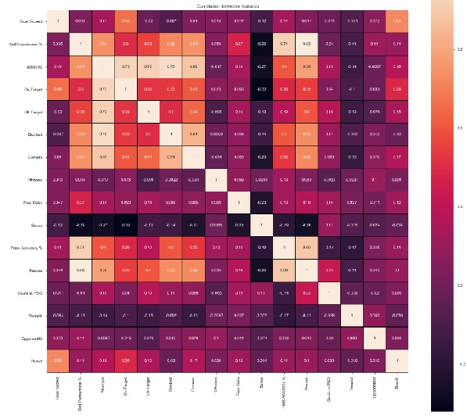
Correlation

Slide 7
Logistic Regression
Logistic regression is good to apply to find success/fail, win/loss, survival/die cases.
For this problem logistic regression is applied and model is evaluated using accuracy score and confusion matrix.
Accuracy score: 0.7307692307692307
Confusion matrix:
  Predicted Lost Predicted Win
  Actual Lost 8 5
  Actual Win 2 11

